Slide 1
Reactive Programming using RxJS
anju munoth

Slide 2
What is RXJS
RxJS is an API for asynchronous programming with observable streams.
RxJS is a library extending ReactiveX for composing asynchronous and event-based programs by using observable sequences with JavaScript.
Provides one core type, the Observable, satellite types (Observer, Schedulers, Subjects) and operators (map, filter, reduce, every, etc) to allow the manipulation of the observable streams with easy and significantly reducing the amount of code needed to solve asynchronous problems.

Slide 3
Streams
Key idea in Reactive Programming is that everything can be a stream.
Streams are cheap and ubiquitous.
A stream is a sequence of ongoing events ordered in time.
Can only emit 3 things: a data typed value, an error, or a termination signal.

Slide 4
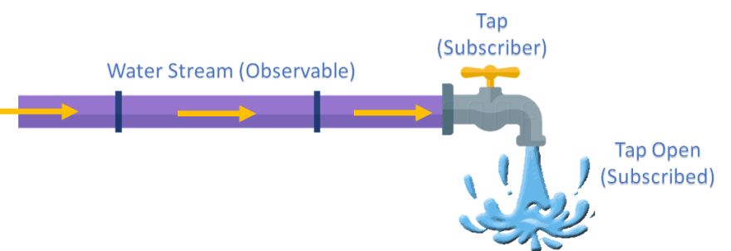
streams --Water pipe with a closing mechanism where each water molecule (or set of) is an emitted value.
Closing mechanism can be triggered manually by turning the tap, representing a termination signal, or implicitly, if the pipe fails to do its function, representing an error.
A closed pipe can no longer push out water and we call it a completed stream.

Slide 5
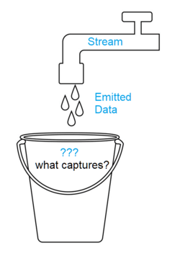
A stream is a sequence of ongoing events ordered in time.
water droplets (data) are being pushed out of the pipe (stream) as time (program execution) passes.
How do we capture these droplets to act on them?

Slide 6
Reactive programming
In most implementations of Reactive Programming- capture these emitted events only asynchronously, by defining functions that are called and passed one of the three appropriate outputs as a parameter:
On value emission: Each time a value is pushed through the stream it will be emitted and captured here.
Can happen multiple times.
On error emission: When the stream error it will be captured here and the stream terminates.
Happens only once.
On termination: When the stream is terminated it will be captured here.
Happens only once.

Slide 7
Operators
Operators offer a way to manipulate streams by transforming them.
A transformation, in our context, is simply a function f that maps a stream into another stream, i.e. f: S1 → S2
This function we call an operator.

Slide 8
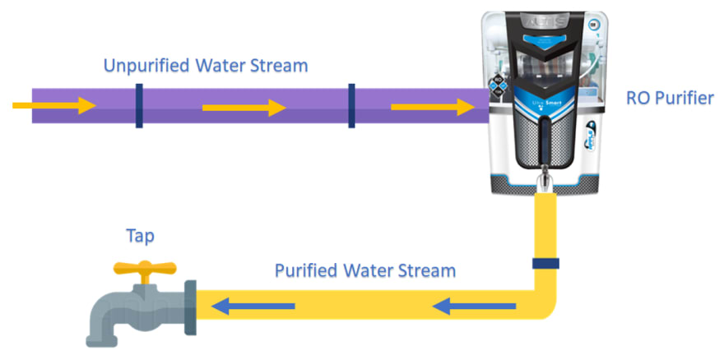
Imagine placing one or more appliances within the pipeline of our stream.
Appliances could have filters in them or could modify the contents of the water (or other transformations) thereby transforming stream into a new stream
Initial stream of type 'Unpurified Water' was transformed into a stream of type 'Purified Water' transforming the data that gets observed at the end of the pipeline from its original form

Slide 9
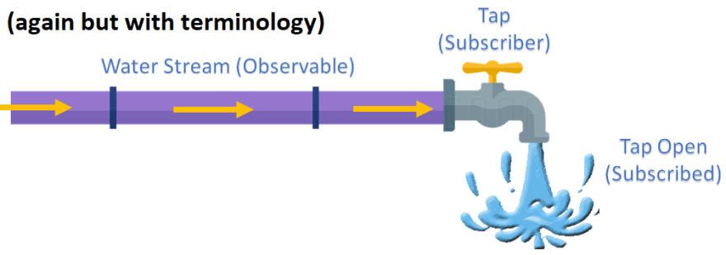

Slide 10
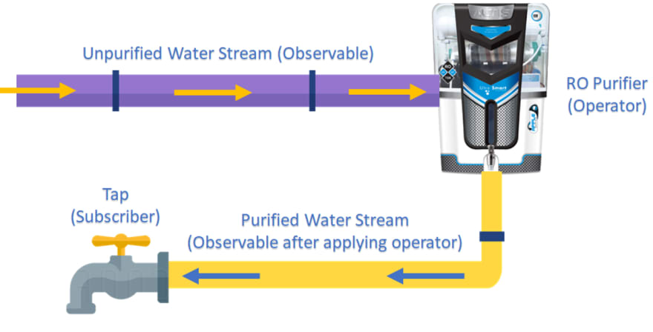

Slide 11
Key Definitions
Stream -> Observable: A structure representing a stream of values over time.
Tap -> Subscriber: Sometimes called the consumer, the code that calls the subscription process on an observable structure.
Turning the tap -> Subscription: The method that opens the stream for the observer.
Closing the tap -> Completing: The action of marking the stream as completed meaning it is terminated.
Bucket -> Observer: The structure that captures our pushed values allowing us to act on them.
Appliances -> Operators: Functions that transform the stream.

Slide 12
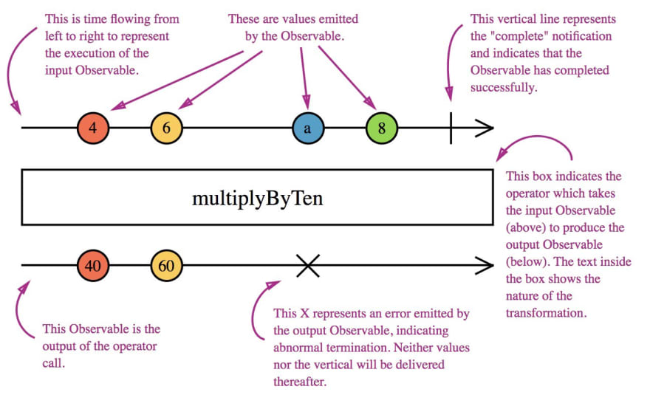

Slide 13
Advantages and disadvantages
Advantages​
Growing very rapidly.​
RxJs alone has 25mil weekly downloads.​
Provides a very high-quality asynchronous API.​
Lightweight & memory optimised.​
Easy error handling.​
Makes asynchronous programming much faster in most applications.​
Disadvantages​
Relatively steep learning curve.​
Implies a functional programming style (data immutability).​
Testing/debugging can be a learning process.

Slide 14
Entities
Observable: represents the idea of an invokable collection of future values or events.
Observer: is a collection of callbacks that knows how to listen to values delivered by the Observable.
Subscription: represents the execution of an Observable, which is primarily useful for cancelling the execution.
Operators: are pure functions that enable a functional programming style of dealing with collections with operations like map, filter, concat, reduce, etc.
Subject: is equivalent to an EventEmitter, and the only way of multicasting a value or event to multiple Observers.
Producer: The code that is subscribing to the observable. This is whoever is being notified of nexted values, and errors or completions.
Consumer: Any system or thing that is the source of values that are being pushed out of the observable subscription to the consumer.

Slide 15
Concepts
Unicast: The act of one producer being observed only one consumer.
An observable is "unicast" when it only connects one producer to one consumer.
Unicast doesn't necessarily mean "cold".
Multicast: The act of one producer being observed by many consumers.
Push: Observables are a push-based type.
That means rather than having the consumer call a function or perform some other action to get a value, the consumer receives values as soon as the producer has produced them, via a registered next handler.
Pull:
Opposite of push-based. In a pull-based type or system, the consumer must request each value the producer has produced manually, perhaps long after the producer has actually done so.
Examples of such systems are Functions and Iterators

Slide 16
Concepts
Cold: An observable is "cold" when it creates a new producer during subscribe for every new subscription.
Are always unicast, being one producer observed by one consumer.
Cold observables can be made hot but not the other way around.
Hot: An observable is "hot", when its producer was created outside of the context of the subscribe action.
Is almost always multicast.
Possible that a "hot" observable is still technically unicast if it is engineered to only allow one subscription at a time, however, there is no straightforward mechanism for this in RxJS, and the scenario is unlikely.
"hot" observables can be assumed to be multicast.
Hot observables cannot be made cold.

Slide 17
import { Observable } from 'rxjs';
/* Instantiate an observable */
const observable = new Observable(subscriber => {
subscriber.next(1); // pushes a value
subscriber.next(2); // pushes another value synchronously
setTimeout(() =>
{
subscriber.next(3); // pushes last value after a wait of 1s
subscriber.complete(); // terminates observable stream
}, 1000);
});

Slide 18
/* Subscribing to an observable */
console.log('just before subscribe’);
const subscription = observable.subscribe({
// The three possible output captures:
next(x) { console.log('got value ' + x); },
error(err) { console.error('something wrong occurred: ' + err); },
complete() { console.log('done'); }
}); // creates subscription object
console.log('just after subscribe');
/* Unsubscribing to an observable using subscription */
setTimeout(() => {
subscription.unsubscribe();
}, 500);
/ Logs:
// just before subscribe
// got value 1
// got value 2
// just after subscribe

Slide 19
cold observable
import { Observable } from "rxjs";
// Creating a cold observable
const observable = Observable.create((observer) => {
observer.next(Math.random()); // We explicitly push the value to the stream
});
// Subscription 1
observable.subscribe((data) => {
console.log(data); // 0.24957144215097515 (random number)
});
// Subscription 2
observable.subscribe((data) => {
console.log(data); // 0.004617340049055896 (random number)
});

Slide 20
Hot observable
hot observable produces data even if no subscribers are interested in the data.
import { Observable } from "rxjs";
// Coming from an event which is constantly emmit values
const observable = Observable.fromEvent(document, 'click');
// Subscription 1
observable.subscribe((event) => {
console.log(event.clientX); // x position of click
});
// Subscription 2
observable.subscribe((event) => {
console.log(event.clientY); // y position of click
});

Slide 21
Promises vs Observables
Promises are eager. Observables are lazy.​
Promises are single-value emissions. Observables are multi-value streams.​
Promises have no cancelling or operator APIs. Observables do.

Slide 22
Observer
Observer is a consumer of values delivered by an Observable.
Observers are simply a set of callbacks, one for each type of notification delivered by the Observable: next, error, and complete.
const observer = {
next: x => console.log('Observer got a next value: ' + x),
error: err => console.error('Observer got an error: ' + err),
complete: () => console.log('Observer got a complete notification'),
};
// To use it, pass it to a subscribe
observable.subscribe(observer);

Slide 23
Operators
RxJS is mostly useful for its operators, even though the Observable is the foundation.
RxJS has a (very) vast library of operators.
import { from } from "rxjs";
import { filter } from "rxjs/operators";
from([1, 2, 3, 4, 5]).pipe(
filter((x) => (x % 2) === 0)
).subscribe(console.log); // [2, 4]

Slide 24
Pipeline
A pipeline is simply a series of operators that get executed in order.
Every pipeline operator must return an observable.
import { from } from "rxjs";
import { filter, take, map } from "rxjs/operators";
from([1, 2, 3, 4, 5]).pipe(
filter((x) => (x % 2) === 0),
take(1),
map((firstValue) => "The first even number was " + firstValue)
).subscribe(console.log);

Slide 25
Subjects
A Subject is like an Observable, but can multicast to many Observers.
Subjects are like EventEmitters: they maintain a registry of many listeners.
Part of a subject is literally an observable and you can get a reference to that observable.
Easiest way to think of a subject :
Subject = Observer + Observable

Slide 26
Subjects
import { Subject, from } from 'rxjs';
const subject = new Subject<number>();
subject.subscribe({
next: (v) => console.log(`observerA: ${v}`)
});
subject.subscribe({
next: (v) => console.log(`observerB: ${v}`)
});
subject.next(1);
subject.next(2);
// Logs:
// observerA: 1
// observerB: 1
// observerA: 2
// observerB: 2

Slide 27
const observable = from([1, 2, 3]);
observable.subscribe(subject); // You can subscribe providing a Subject
// Logs:
// observerA: 1
// observerB: 1
// observerA: 2
// observerB: 2
// observerA: 3
// observerB: 3

Slide 28
Defining observers
A handler for receiving observable notifications implements the Observer interface.
An object that defines callback methods to handle the three types of notifications that an observable can send
An observer object can define any combination of these handlers.
If you don't supply a handler for a notification type, the observer ignores notifications of that type.

Slide 29
Defining observers
NOTIFICATION TYPE | DETAILS
next | Required. A handler for each delivered value. Called zero or more times after execution starts.
error | Optional. A handler for an error notification. An error halts execution of the observable instance.
complete | Optional. A handler for the execution-complete notification. Delayed values can continue to be delivered to the next handler after execution is complete.

Slide 30
Subscribing
An Observable instance begins publishing values only when someone subscribes to it.
Subscribe by calling the subscribe() method of the instance, passing an observer object to receive the notifications.

Slide 31
Methods to create an observable
RXJS METHODS | DETAILS
of(...items) | Returns an Observable instance that synchronously delivers the values provided as arguments.
from(iterable) | Converts its argument to an Observable instance. This method is commonly used to convert an array to an observable.

Slide 32
// Create simple observable that emits three values
const myObservable = of(1, 2, 3);
// Create observer object
const myObserver = {
next: (x: number) => console.log('Observer got a next value: ' + x),
error: (err: Error) => console.error('Observer got an error: ' + err),
complete: () => console.log('Observer got a complete notification'),
};
// Execute with the observer object
myObservable.subscribe(myObserver);
// Logs:
// Observer got a next value: 1
// Observer got a next value: 2
// Observer got a next value: 3
// Observer got a complete notification

Slide 33
// This function runs when subscribe() is called
function sequenceSubscriber(observer: Observer<number>) {
// synchronously deliver 1, 2, and 3, then complete
observer.next(1);
observer.next(2);
observer.next(3);
observer.complete();
// unsubscribe function doesn't need to do anything in this
// because values are delivered synchronously
return {unsubscribe() {}};
}
// Create a new Observable that will deliver the above sequence
const sequence = new Observable(sequenceSubscriber);
// execute the Observable and print the result of each notification
sequence.subscribe({
next(num) { console.log(num); },
complete() { console.log('Finished sequence'); }
});
// Logs:
// 1
// 2
// 3
// Finished sequence
Creating observables using Constructor

Slide 34
Create an observable from a promise
import { from, Observable } from 'rxjs';
// Create an Observable out of a promise
const data = from(fetch('/api/endpoint'));
// Subscribe to begin listening for async result
data.subscribe({
next(response) { console.log(response); },
error(err) { console.error('Error: ' + err); },
complete() { console.log('Completed'); }
});

Slide 35
Create an observable from a counter
import { interval } from 'rxjs';
// Create an Observable that will publish a value on an interval
const secondsCounter = interval(1000);
// Subscribe to begin publishing values
const subscription = secondsCounter.subscribe(n =>
console.log(`It's been ${n + 1} seconds since subscribing!`));

Slide 36
Map operator
import { of } from 'rxjs';
import { map } from 'rxjs/operators';
const nums = of(1, 2, 3);
const squareValues = map((val: number) => val * val);
const squaredNums = squareValues(nums);
squaredNums.subscribe(x => console.log(x));
// Logs
// 1
// 4
// 9

Slide 37
Standalone pipe function
import { of, pipe } from 'rxjs';
import { filter, map } from 'rxjs/operators';
const nums = of(1, 2, 3, 4, 5);
// Create a function that accepts an Observable.
const squareOddVals = pipe(
filter((n: number) => n % 2 !== 0),
map(n => n * n)
);
// Create an Observable that will run the filter and map functions
const squareOdd = squareOddVals(nums);
// Subscribe to run the combined functions
squareOdd.subscribe(x => console.log(x));

Slide 38
Observable.pipe function
import { of } from 'rxjs';
import { filter, map } from 'rxjs/operators';
const squareOdd = of(1, 2, 3, 4, 5)
.pipe(
filter(n => n % 2 !== 0),
map(n => n * n)
);
// Subscribe to get values
squareOdd.subscribe(x => console.log(x));

Slide 39
Error handling
import { Observable, of } from 'rxjs';
import { ajax } from 'rxjs/ajax';
import { map, catchError } from 'rxjs/operators';
// Return "response" from the API. If an error happens,
// return an empty array.
const apiData = ajax('/api/data').pipe(
map((res: any) => {
if (!res.response) {
throw new Error('Value expected!');
}
return res.response;
}),
catchError(() => of([]))
);
apiData.subscribe({
next(x: T) { console.log('data: ', x); },
error() { console.log('errors already caught... will not run'); }
});

Slide 40
Retry failed observable
import { Observable, of } from 'rxjs';
import { ajax } from 'rxjs/ajax';
import { map, retry, catchError } from 'rxjs/operators';
const apiData = ajax('/api/data').pipe(
map((res: any) => {
if (!res.response) {
console.log('Error occurred.');
throw new Error('Value expected!');
}
return res.response;
}),
retry(3), // Retry up to 3 times before failing
catchError(() => of([]))
);
apiData.subscribe({
next(x: T) { console.log('data: ', x); },
error() { console.log('errors already caught... will not run'); }
});

Slide 41
Naming conventions for observables
Because Angular applications are mostly written in TypeScript, will typically know when a variable is an observable.
Although the Angular framework does not enforce a naming convention for observables, will often see observables named with a trailing "$" sign.
This can be useful when scanning through code and looking for observable values.
Also, if you want a property to store the most recent value from an observable, it can be convenient to use the same name with or without the "$".

Slide 42
import { Component } from '@angular/core';
import { Observable } from 'rxjs';
@Component({
selector: 'app-stopwatch',
templateUrl: './stopwatch.component.html'
})
export class StopwatchComponent {
stopwatchValue = 0;
stopwatchValue$!: Observable<number>;
start() {
this.stopwatchValue$.subscribe(num =>
this.stopwatchValue = num
);
}
}

Slide 43
Async pipe
@Component({
selector: 'async-observable-pipe',
template: `<div><code>observable|async</code>:
Time: {{ time | async }}</div>`
})
export class AsyncObservablePipeComponent {
time = new Observable<string>(observer => {
setInterval(() => observer.next(new Date().toString()), 1000);
});
}

Slide 44
Cancellation
Observable subscriptions are cancellable.
Unsubscribing removes the listener from receiving further values, and notifies the subscriber function to cancel work.
const subscription = observable.subscribe(() => {
// observer handles notifications
});
subscription.unsubscribe();

Slide 45
Summary
Observables are used to watch these streams and emit functions when a value, error or complete signal is returned.
Observables can be subscribed to by an Observer.
Observer is there to execute some piece of code whenever observable sends any value, emits error or Observable reports that it is done
Subscription means the subscribe method using which we tell the Observable that someone(Observer) is waiting for the values , errors from the stream of data.
After receiving data Observer implements 3 methods using subscribe function next ( )
error ( )
complete ( )

Slide 46
The next method will be called whenever a value is returned from the Observable.
The error method is called whenever an error is returned from the Observable.
The complete method is called whenever an observable is done i.e no more values will be emitted in the future from the observable.
Some of the Observables might never finish as well.(Ex. When an observable is created for button click it never ends as user can click any point of time the button at any co-ordinate )

Slide 47
